Slide 1

Machine Learning What is it? Why is it?
Drew Dimmery

Slide 2

Me
PhD in Political Methodology from NYU
Experimentation, Causal Inference, Machine Learning
Facebook Core Data Science (now “Meta Central Applied Science”)
Adaptive Experimentation team
Bayesian Optimization
Routine Experimentation
Academia
Starting at Hertie this year
Research:
Better integration of machine learning and experiments
Causal Machine Learning
Helping people study the internet using these tools

Slide 3
This class
Broad perspective to answer the central question
What is Machine Learning?
Historical perspective
Where does ML come from?
How much of what we see is new?
Ahistorical perspective
What are the problems ML is well-suited to solve?
What, general, are the problems ML seeks to navigate?

Slide 4
An intellectual history of AI/ML
A story of boundless optimism and countless “failures”

Slide 5
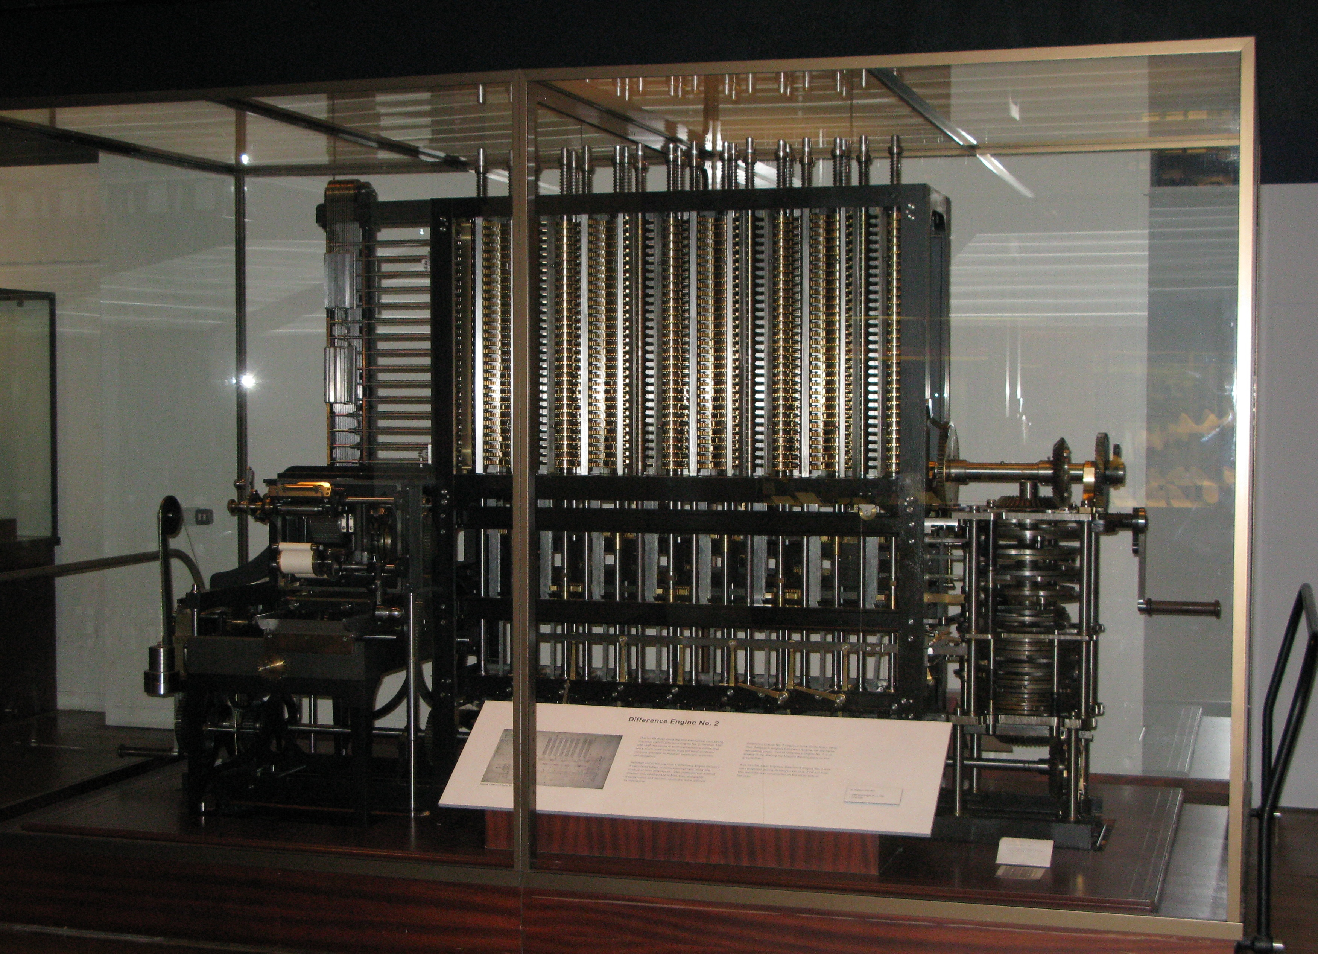
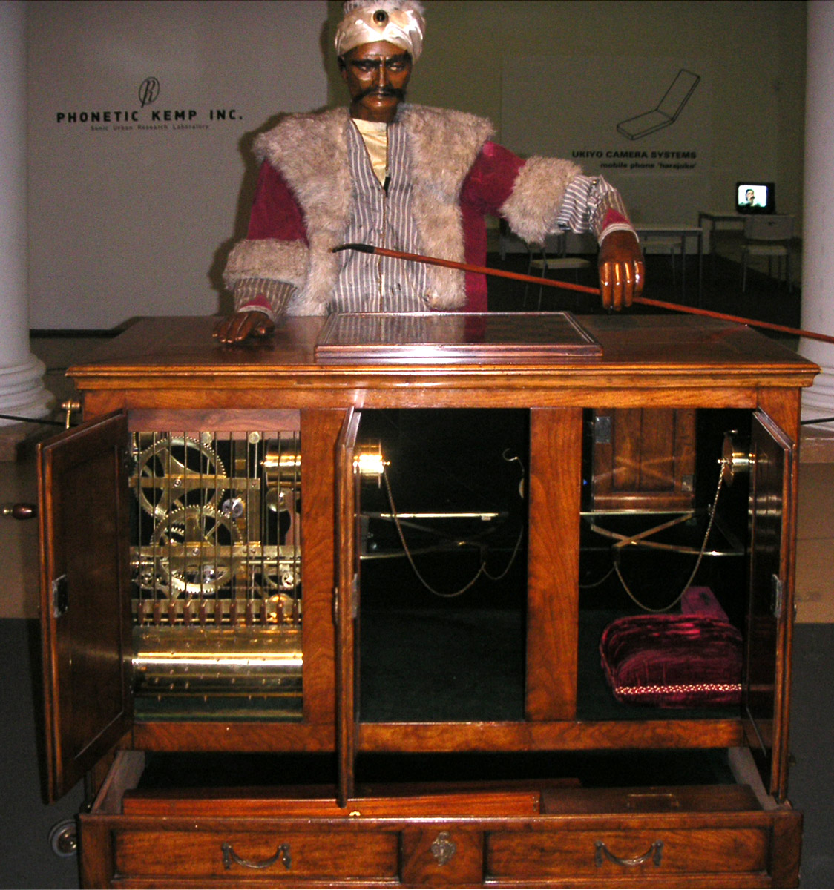
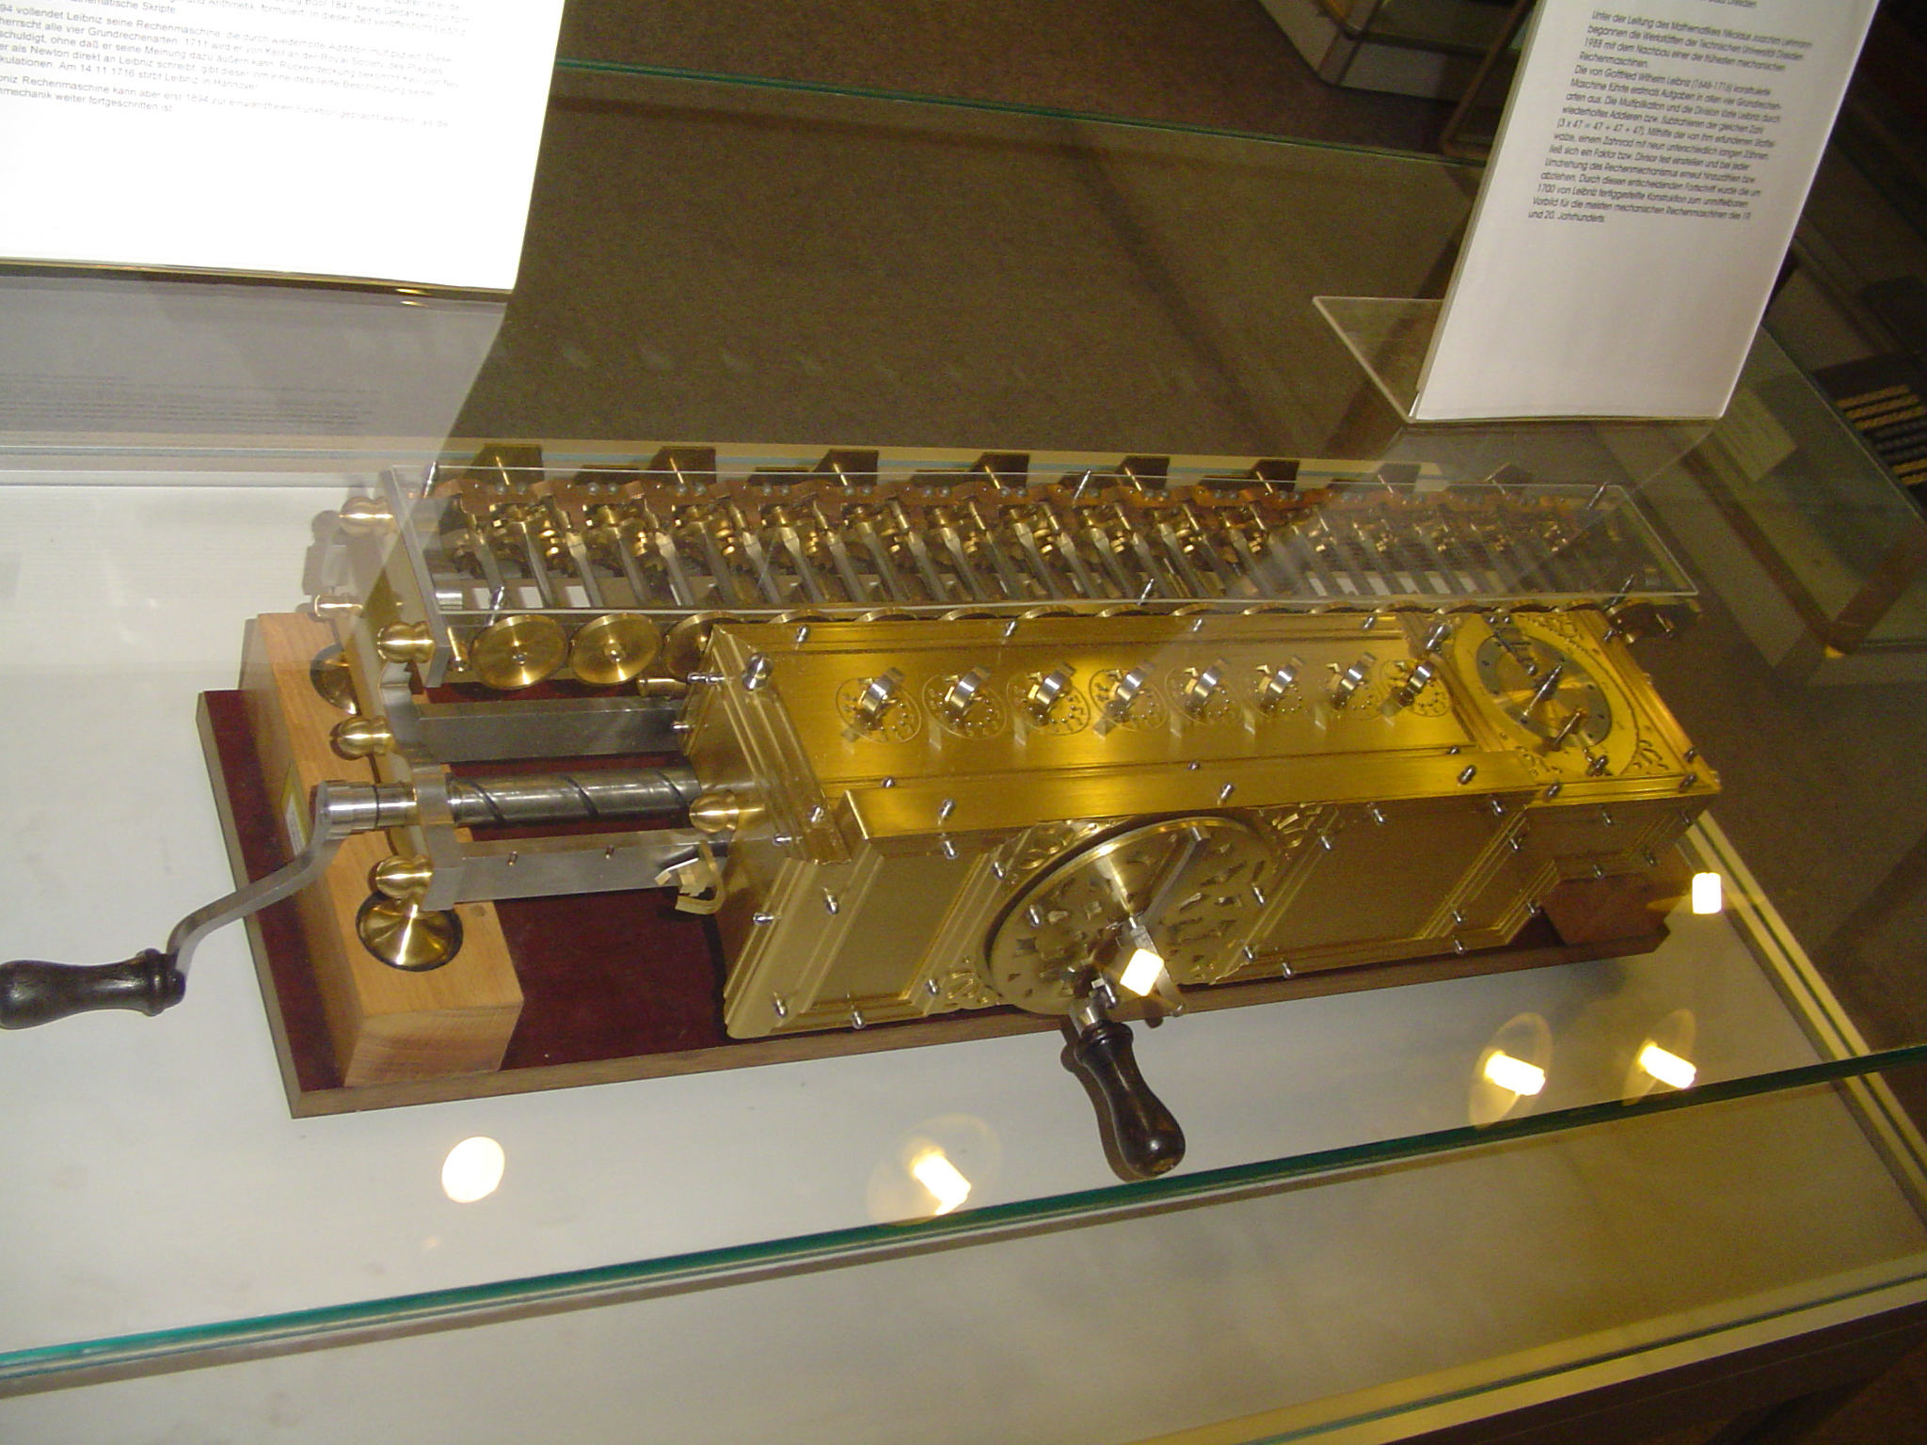
Origins of Computation
1672-1694: Leibniz’s stepped reckoner
1780s: “The Turk”
1820s: Babbage’s Difference Engine
“a thinking or ... reasoning machine”
“It is desirable to guard against the possibility of exaggerated ideas that arise as to the powers" of the machine.”

Slide 6
Important ideas bubbling around
Mathematics
Russell and Whitehead’s Principia Mathematica
Gödel’s Incompleteness theorem
Philosophy
Wiener Kreis / Logical positivism
Utilitarianism
Computer Science
Algorithms
Computability
Cognitive science
Economics
Notes:
Proved 1+1 = 2 on page 379

Slide 7
Computational Theory of the Mind
René Descartes, 1641
Cartesian dualism – Mind-body dualism
Thomas Hobbes, 1651
"reason is nothing but reckoning"
Herb Simon, 1944
“Any rational decision may be viewed as a conclusion reached from certain premises…. The behavior of a rational person can be controlled, therefore, if the value and factual premises upon which he bases his decisions are speciﬁed for him.”
Warren McCulloch, 1960s (based on work in 1943)
“brains do not secrete thought as the liver secretes bile, but that they compute thought as electronic computers calculate numbers”
Rodney Brooks, 2002
People tend to “overanthropomorphize humans… who are after all mere machines”
Notes:
Heidegger: Dasein -- This ontological basis of Heidegger's work thus opposes the Cartesian "abstract agent" in favour of practical engagement with one's environment.^{[7]: 61} Dasein is revealed by projection into, and engagement with, a personal world^{[8]: 220} —a never-ending process of involvement with the world as mediated through the projects of the self.

Slide 8
Not-yet AI
Cybernetics up to the mid 1950s

Slide 9
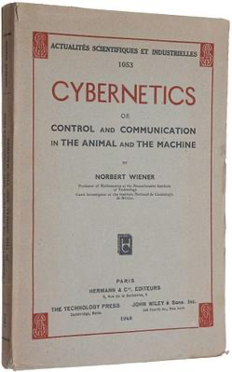
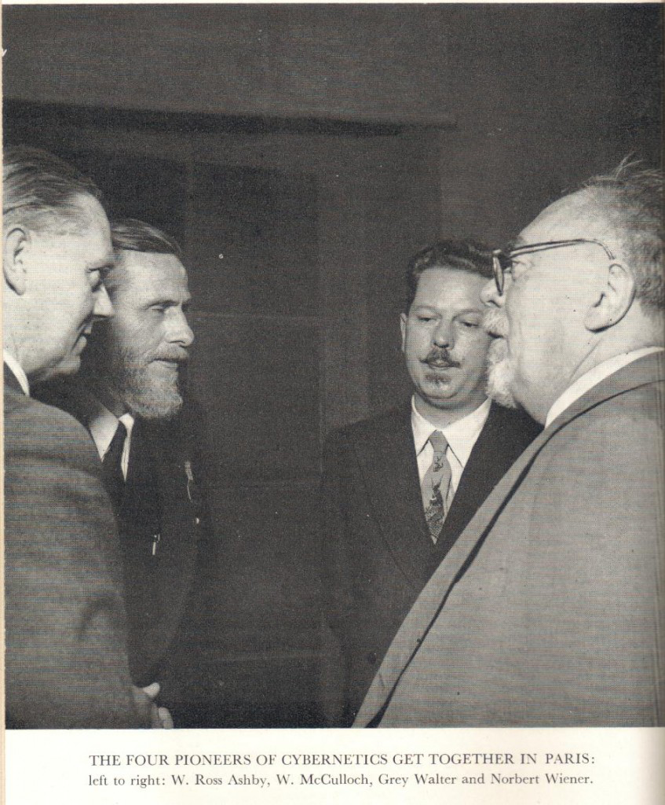
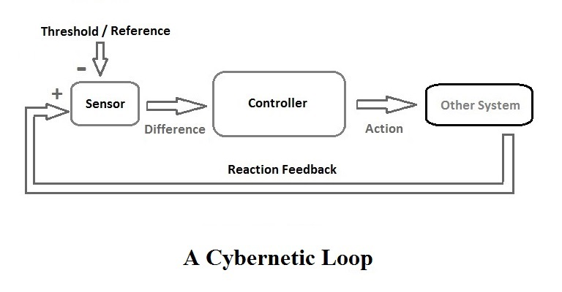
Cybernetics
Primary figures
Norbert Wiener
W. Ross Ashby
W. Grey Walter
Warren McCulloch

Slide 10
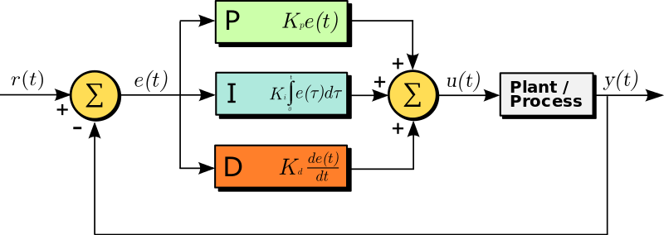
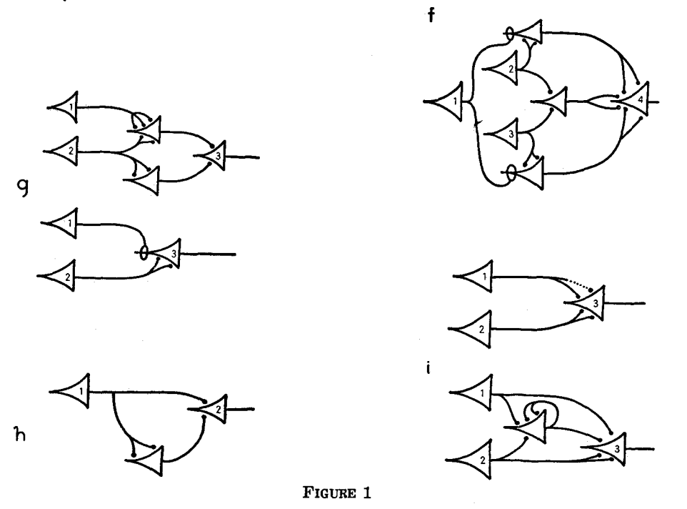
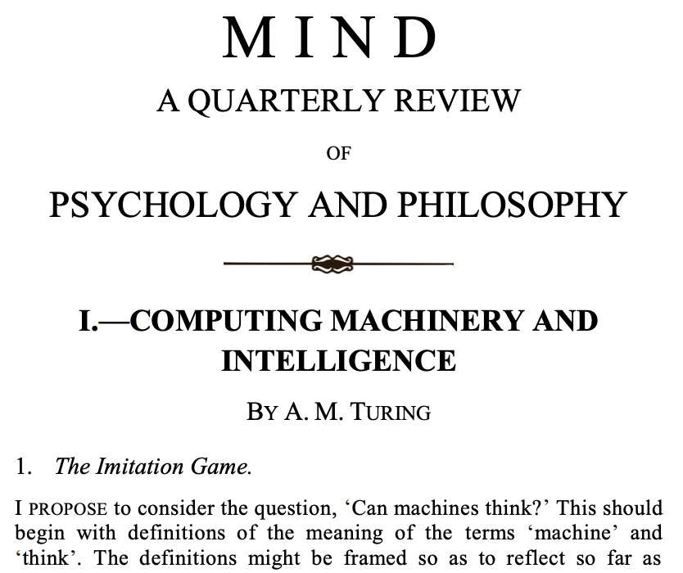
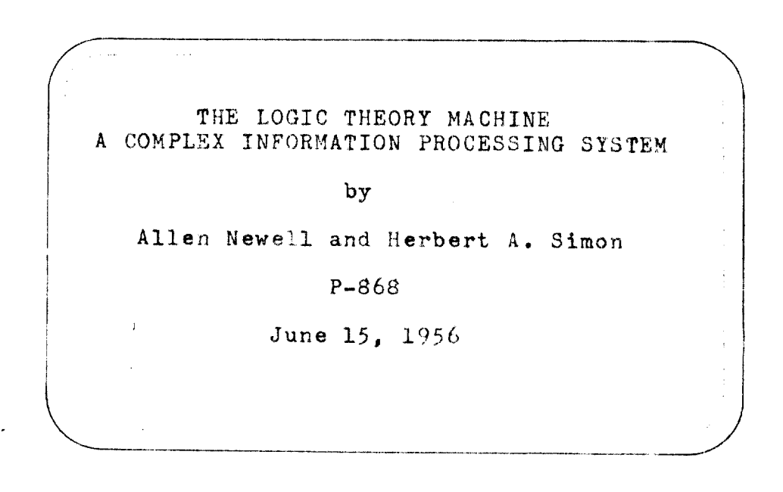
Contributions
Minorsky, 1922
PID controller for naval steering
Cybernetics ⇔ κυβερνήτης (“helmsperson”)
Pitts and McCulloch
Early neural networks
Turing
“Computing Machinery and Intelligence”
Newell and Simon
“Logic Theorist”
Notes:
In January 1956, we assembled my wife and three children together with some graduate students. To each member of the group, we gave one of the cards, so that each one became, in effect, a component of the computer program ... Here was nature imitating art imitating nature.
Logic Theorist soon proved 38 of the first 52 theorems in chapter 2 of the Principia Mathematica. The proof of theorem 2.85 was actually more elegant than the proof produced laboriously by hand by Russell and Whitehead. Simon was able to show the new proof to Russell himself who "responded with delight".^{[3]} They attempted to publish the new proof in The Journal of Symbolic Logic, but it was rejected on the grounds that a new proof of an elementary mathematical theorem was not notable, apparently overlooking the fact that one of the authors was a computer program.
[We] invented a computer program capable of thinking non-numerically, and thereby solved the venerable mind-body problem, explaining how a system composed of matter can have the properties of mind.

Slide 11
Early AI
1956 to mid-1970s

Slide 12
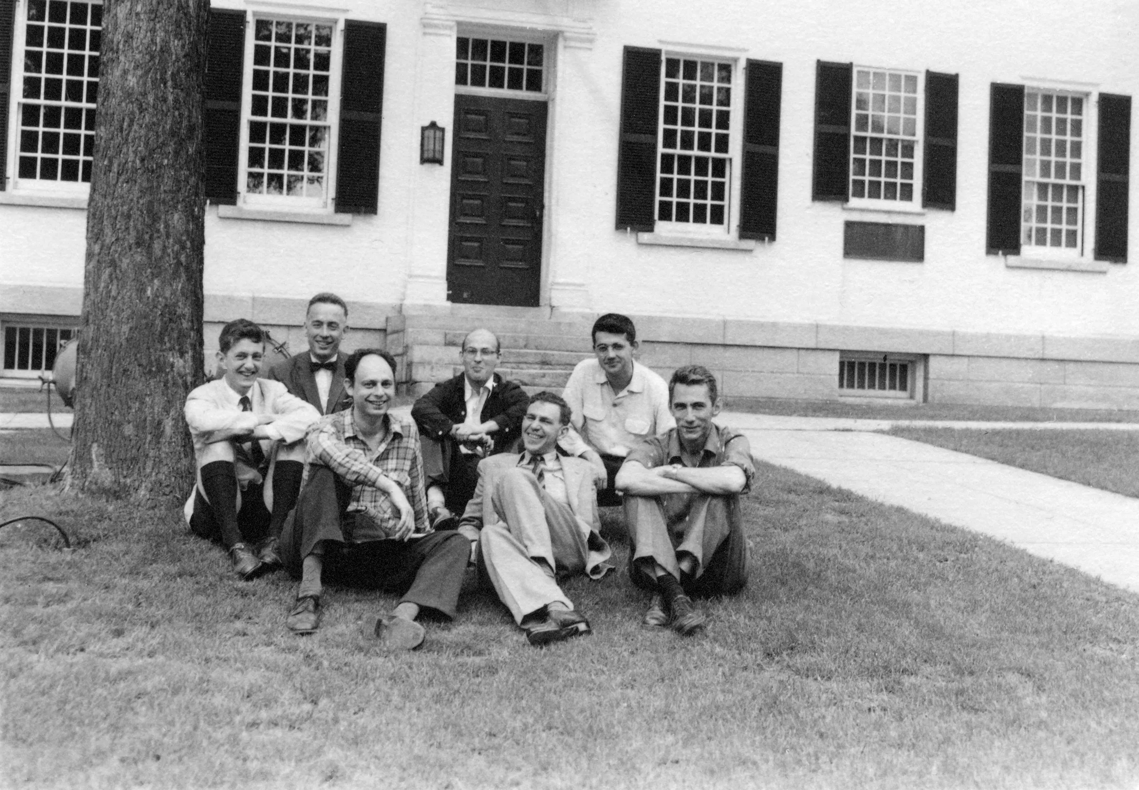
Key figures
Marvin Minsky
Allen Newell
Herbert Simon
Frank Rosenblatt
Seymour Papert
Joseph Weizenbaum
Notes:
1956 Dartmouth Conference
We propose that a 2 month, 10 man study of artiﬁcial intelligence be carried out during the summer of 1956 at Dartmouth College in Hanover, New Hampshire. The study is to proceed on the basis of the conjecture that every aspect of learning or any other feature of intelligence can in principle be so precisely described that a machine can be made to simulate it. An attempt will be made to ﬁnd how to make machines use language, form abstractions and concepts, solve kinds of problems now reserved for humans, and improve themselves. We think that a signiﬁcant advance can be made in one or more of these problems if a carefully selected group of scientists work on it together for a summer.
In the back row, from left to right, we see Oliver Selfridge, Nathaniel Rochester, Marvin Minsky, and John McCarthy. Sitting in front on the left is Ray Solomonoff, and on the right, Claude Shannon.
Herb Simon – Political Scientist

Slide 13
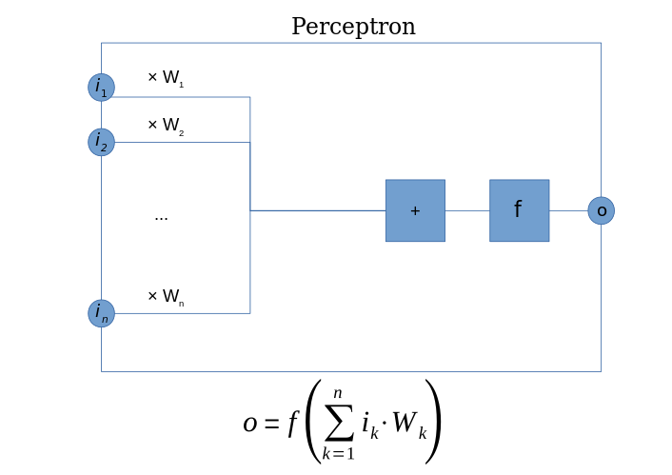

Contributions
Newell and Simon: Reasoning as search
Rosenblatt’s Perceptron
Weizenbaum’s ELIZA
Minsky & Papert’s ”micro-worlds”
1958, Simon and Newell:
"within ten years a digital computer will be the world's chess champion" and "within ten years a digital computer will discover and prove an important new mathematical theorem."
1965, Simon:
"machines will be capable, within twenty years, of doing any work a man can do."
1967, Minsky:
"Within a generation ... the problem of creating 'artificial intelligence' will substantially be solved."
1970, Minsky:
"In from three to eight years we will have a machine with the general intelligence of an average human being."
Notes:
Take a recent example, Negroponte's Media Lab, where instead of "perish or publish" it's "demo or die." I think that's a problem. I think AI suffered from that a lot, because it led to "Potemkin villages", things which - for the things they actually did in the demo looked good, but when you looked behind that there wasn't enough structure to make it really work more generally. – Winograd in 1991
Simon claimed, “We have invented a computer program capable of thinking non-numerically, and thereby solved the venerable mind–body problem.”
1966 – Summer Vision Project -- about 10 students – primary goal to “construct a system of programs that will divide a vidisector picture into regions such as “likely objects” “likely background areas” ”chaos”. … The final goal is OBJECT IDENTIFICATION.” – Papert https://people.csail.mit.edu/brooks/idocs/AIM-100.pdf

Slide 14
A typology of (some) data tasks
Description
Summarizing or representing data in a compact way
What is the state of the world?
Prediction
Predicting new or future observations
What will the state of the world be?
Given what we know about part of the world, what does that imply about other parts?
Explanation
Causal explanation
How do elements of the world relate together?
What would happen if we changed one piece?

Slide 15
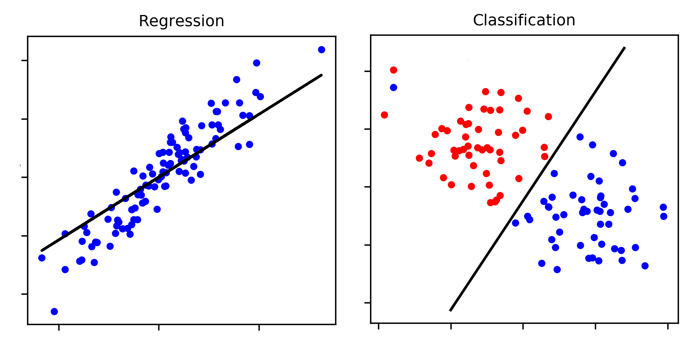
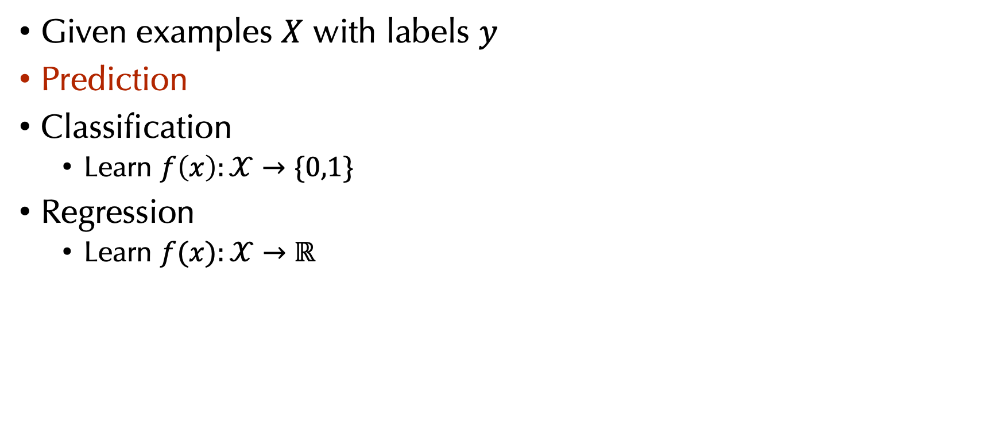
Supervised Learning
Given examples $X$ with labels $y$
Prediction
Classification
Learn $f\left(x\right):𝒳→\{0,1\}$
Regression
Learn $f(x):𝒳→ℝ$

Slide 16
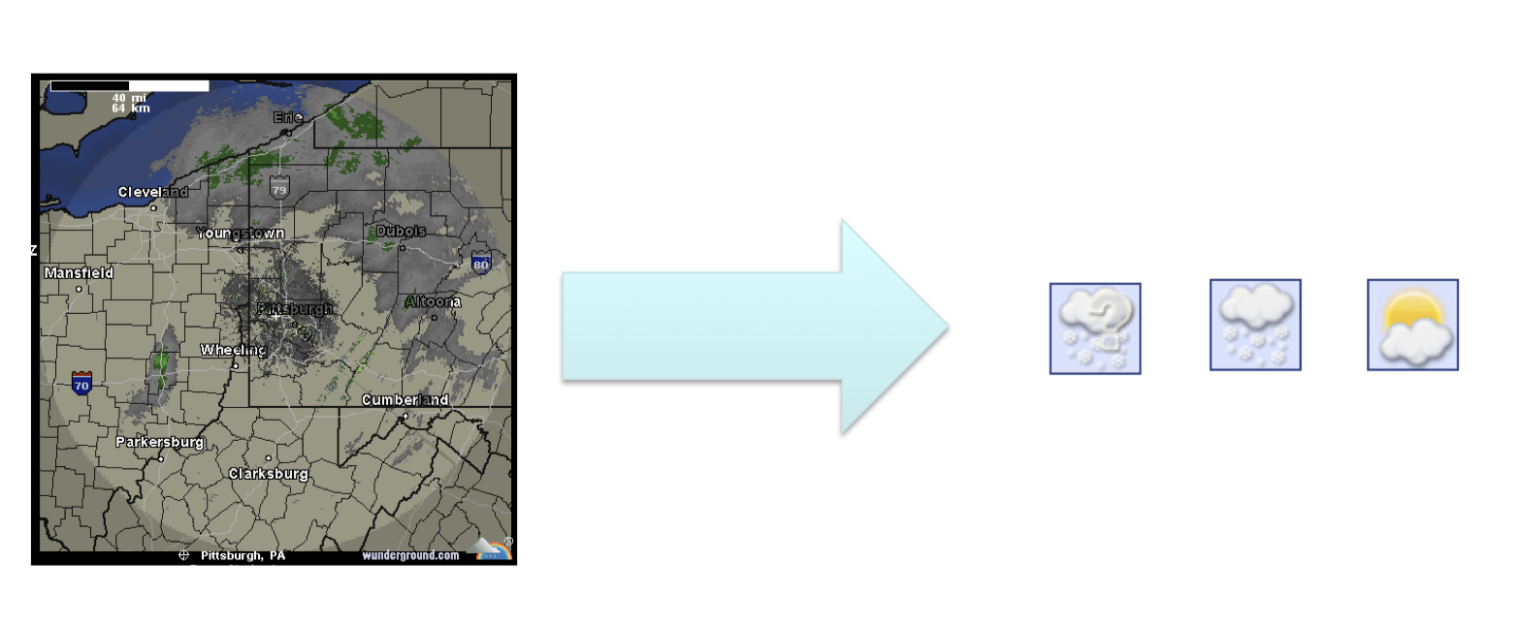
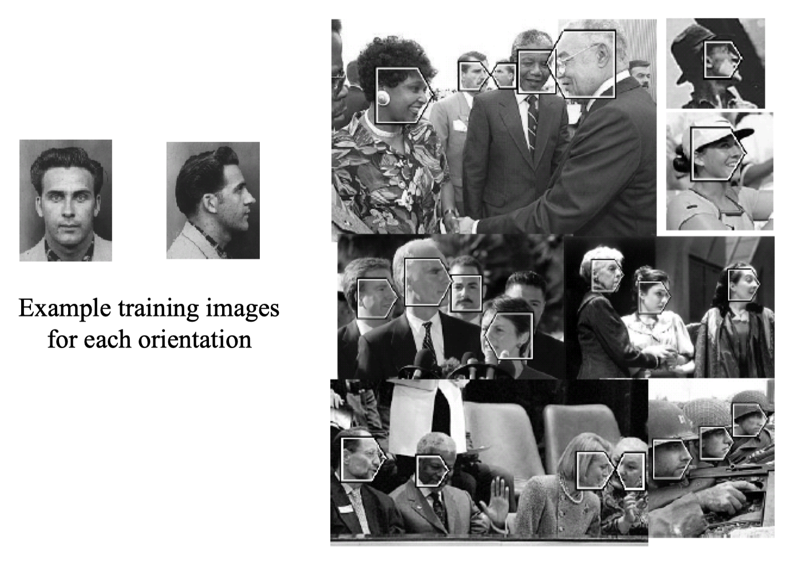
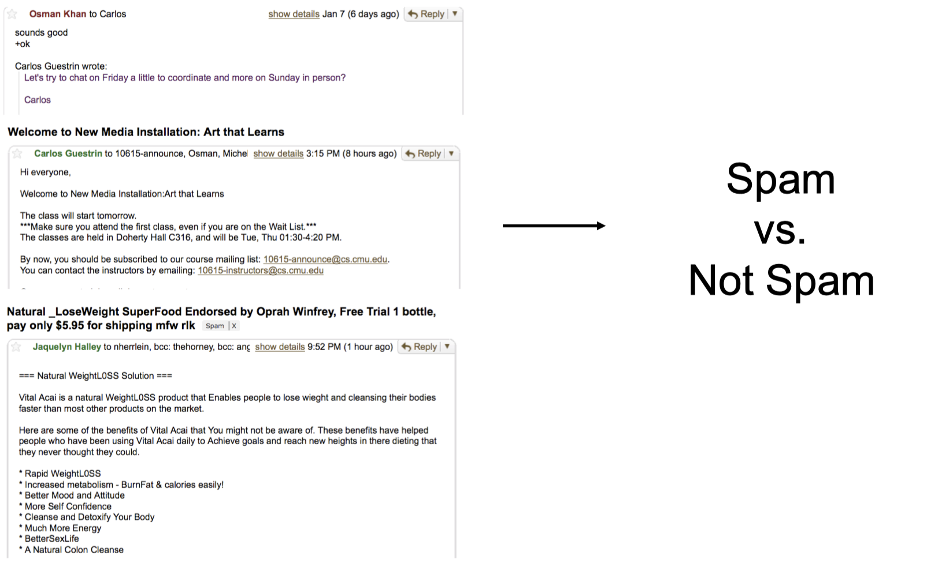
Classification examples

Slide 17
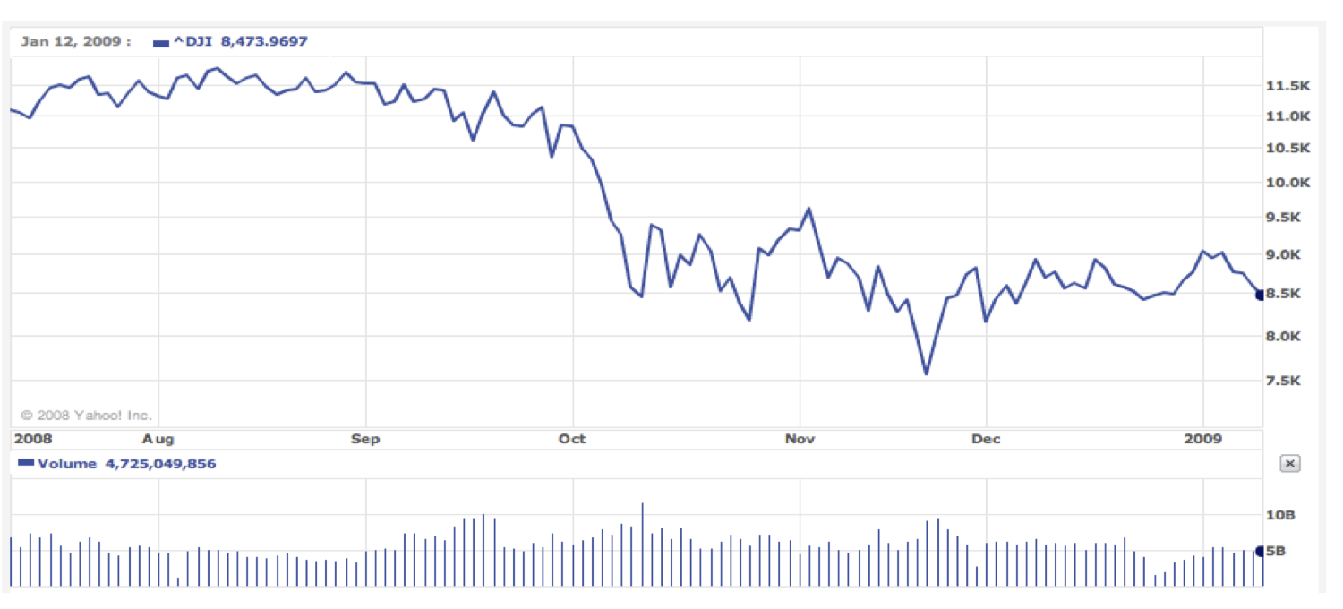
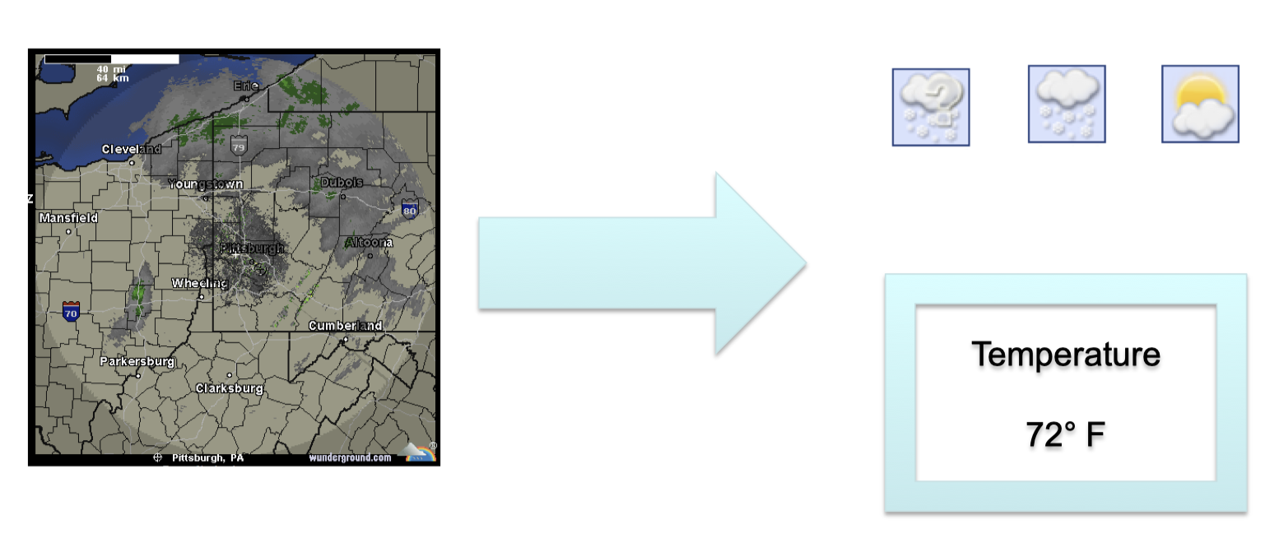
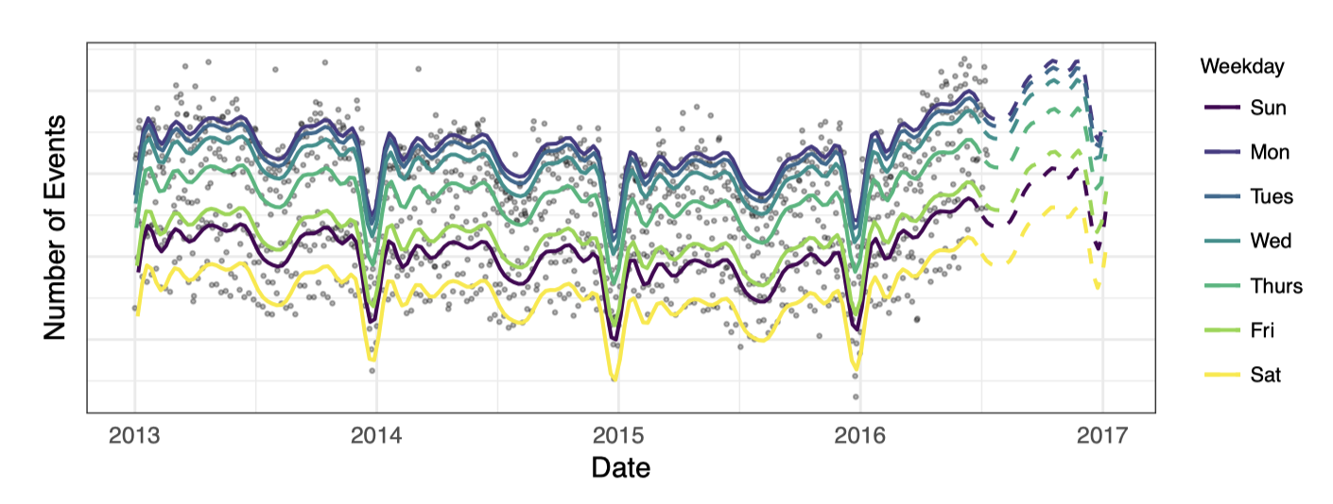
Regression examples

Slide 18
AI Winter (it’s so over)
Mid 1970s to 1980

Slide 19
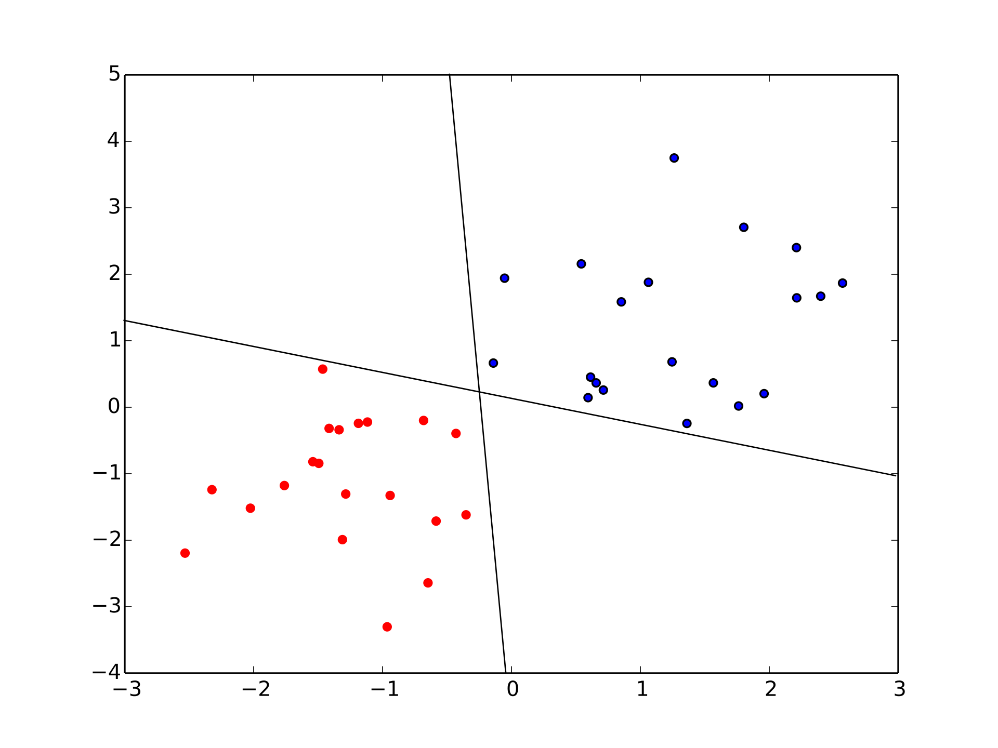
Problems
Funding dried up
Lighthill Report in the UK
Hardware might not be ready
Moore’s law
Expectations about scaling were unreasonable
Low complexity of micro-worlds
Minsky and Papert showed problems with Perceptrons
Cannot learn certain simple functions
Does not have a unique solution
Notes:
The report stated that AI researchers had failed to address the issue of combinatorial explosion when solving problems within real-world domains. That is, the report states that AI techniques may work within the scope of small problem domains, but the techniques would not scale up well to solve more realistic problems.
Efron showed the inconsistency of convergence for linearly separable data
it was impossible for these classes of network to learn an XOR function. It is often believed (incorrectly) that they also conjectured that a similar result would hold for a multi-layer perceptron network. However, this is not true, as both Minsky and Papert already knew that multi-layer perceptrons were capable of producing an XOR function.

Slide 20
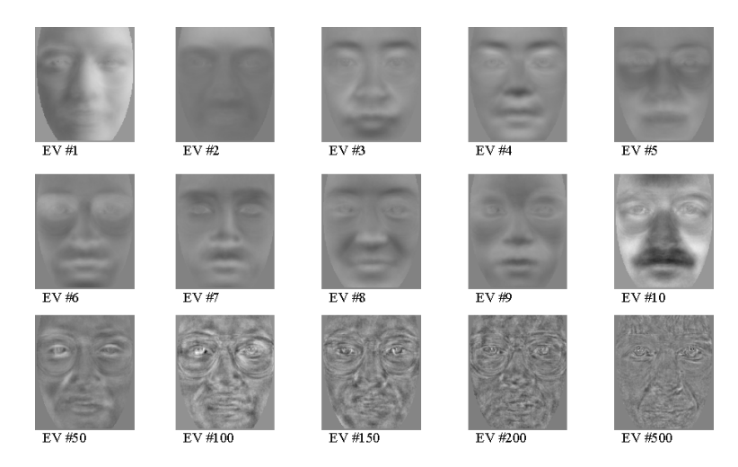
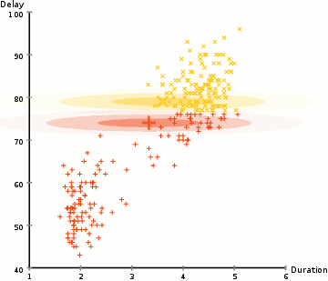
Unsupervised Learning
Clustering
Representation
e.g. “eigenfaces”

Slide 21
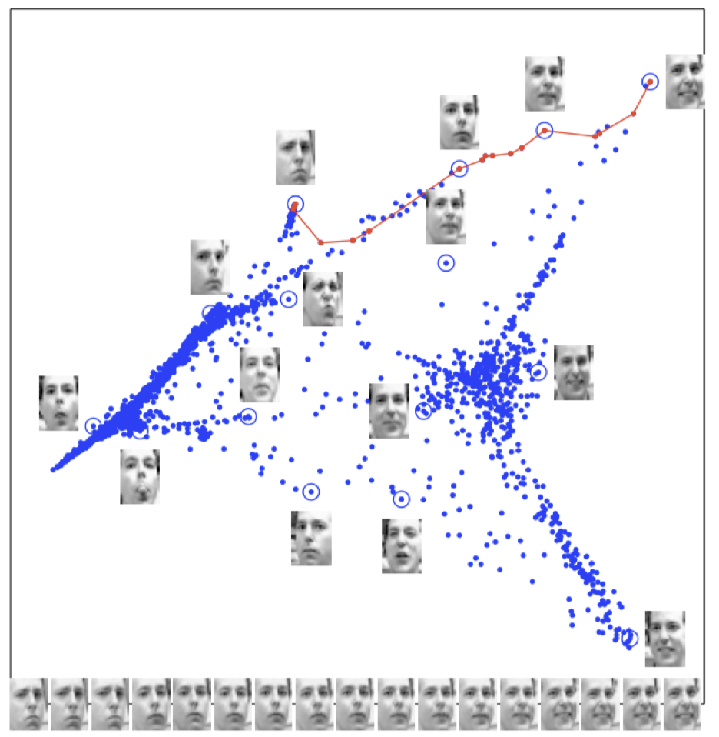
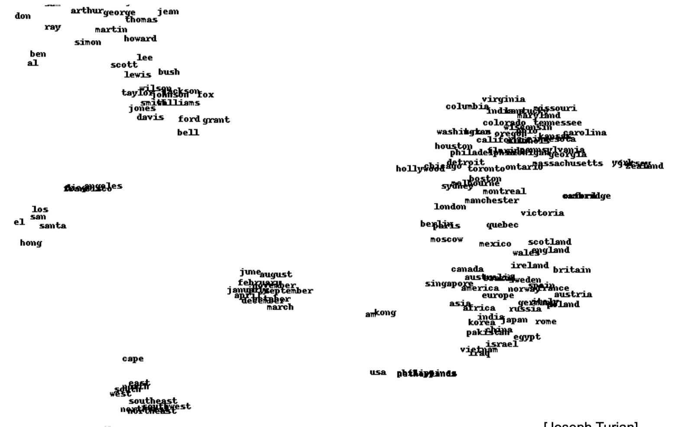
More examples

Slide 22
We’re so back
1980s

Slide 23
Key ideas
Knowledge-based systems
“Don’t tell the program what to do, tell it what to know.”
Knowledge-base
Inference engine
Expert systems
For a very specific domain
Intended to emulate experts
Edward Feigenbaum (and students)
Dendral: to identify novel organic molecules (with chemist Carl Djerassi)
Return of neural nets
Backpropagation!
Notes:
Douglas Lenat: "Intelligence is ten million rules."^{[28]} This refers to the prior and tacit knowledge that authors presume their readers all possess (such as "if person x knows person y, then x's date of death can't be earlier than y's date of birth") not counting the vastly larger number of "facts" such as one might find in Wikipedia or by Googling.

Slide 24
It’s so over?
Late-80s – early 90s

Slide 25
What was happening?
Commercial busts
Government computing funding moved away from AI (again)
Much of the hardware undergirding was killed by IBM and Apple
Issues with neural networks
E.g. the vanishing gradient problem
Embodied reason, e.g. Rodney Brooks
1990: ”the world is its own best model. It is always exactly up to date. It always has every detail there is to be known. The trick is to sense it appropriately and often enough.”

Slide 26
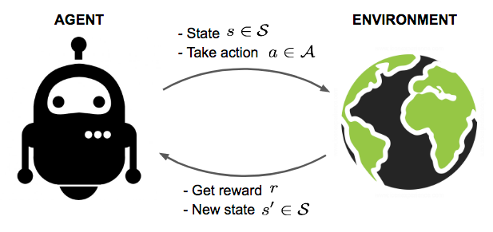
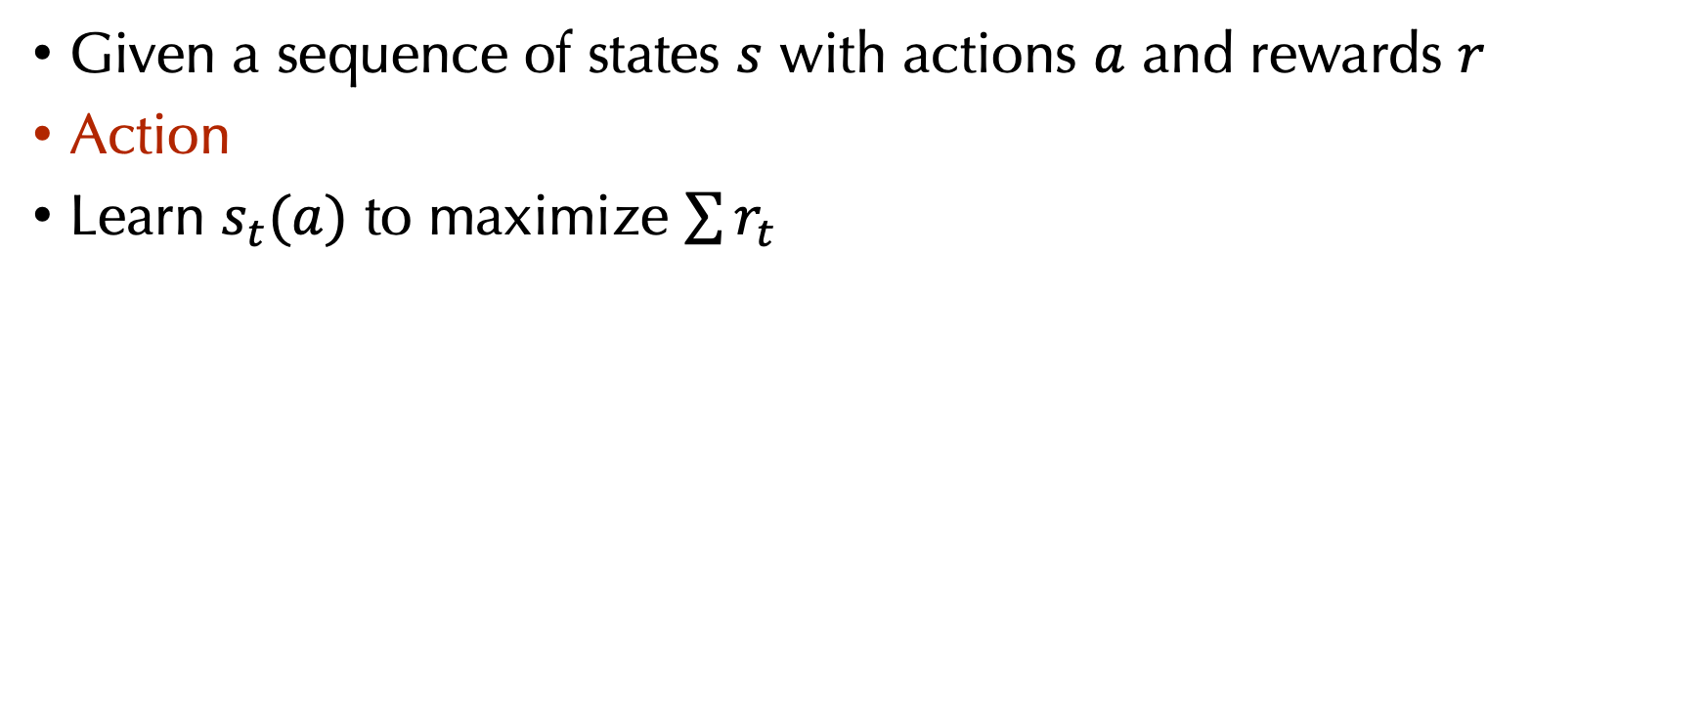
Reinforcement Learning
Given a sequence of states $s$ with actions $a$ and rewards $r$
Action
Learn $s_{t}(a)$ to maximize $\sum{r_{t}}$

Slide 27
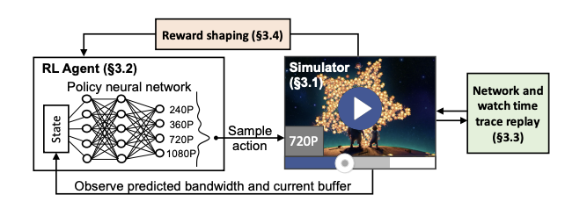
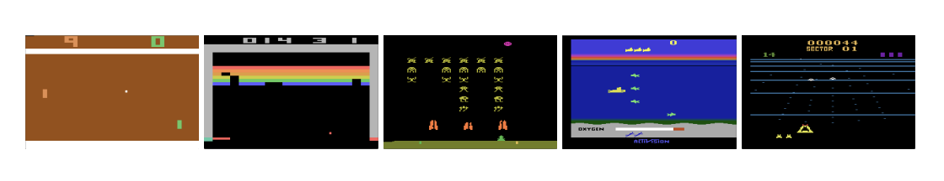
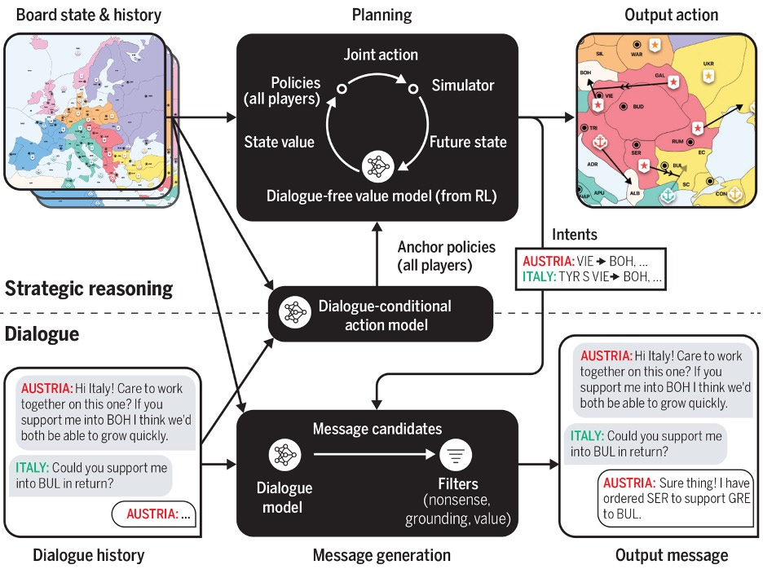
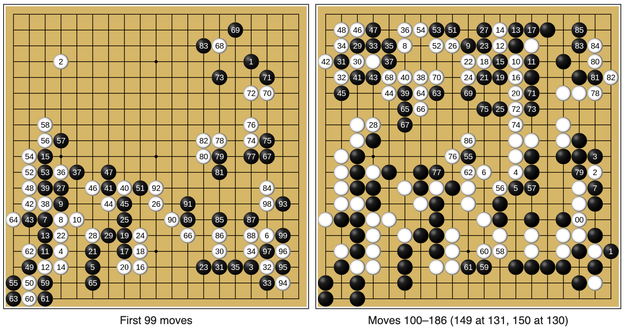
Examples

Slide 28
Maturing ML (we’re so back)
From early/mid-90s to early-2010s

Slide 29
Key Ideas
Rigor
Probability, decision theory, etc
Judea Pearl
Evaluation
Cross-validation
Challenges
Replicability
Code and data sharing
Open Source
Also open-access
Some divergence between AI / ML
Bagging
Leo Breiman, 1996
Boosting
Robert Schapire, 1990
Stacking
Wolpert 1992
Support Vector Machines
Vladimir Vapnik, Corinna Cortes, 1995
Some successes of neural networks
Yann Lecun, 1989: LeNet for digit recognition

Slide 30
Deep learning and AI
Early 2010s to now

Slide 31
Key Successes
The use of GPUs to vastly increase computational performance of matrix multiplication
Donoho: “Frictionless reproducibility”
Data, Re-execution, Challenges
2009: Neural nets win pattern recognition contests
Graves, Schmidhuber
2012: AlexNet wins ImageNet competition
Krizhevsky, Sutskever, Hinton
Transformers, GPT, etc
Notes:
https://arxiv.org/abs/2310.00865 – Data science at the singularity

Slide 32
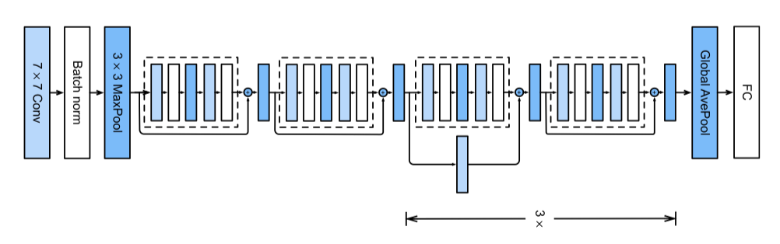
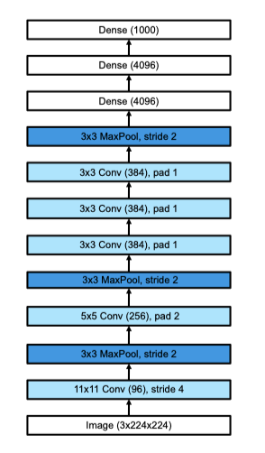
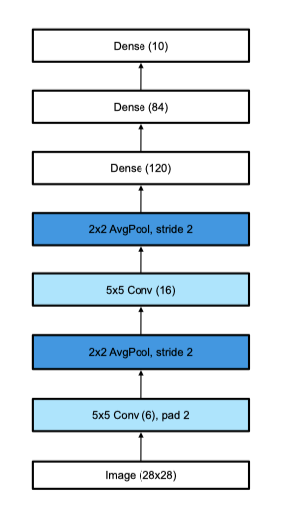
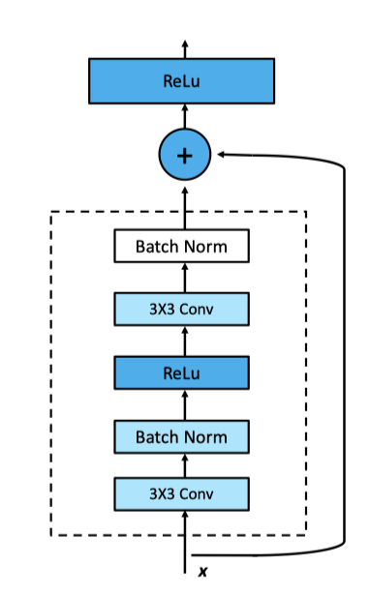
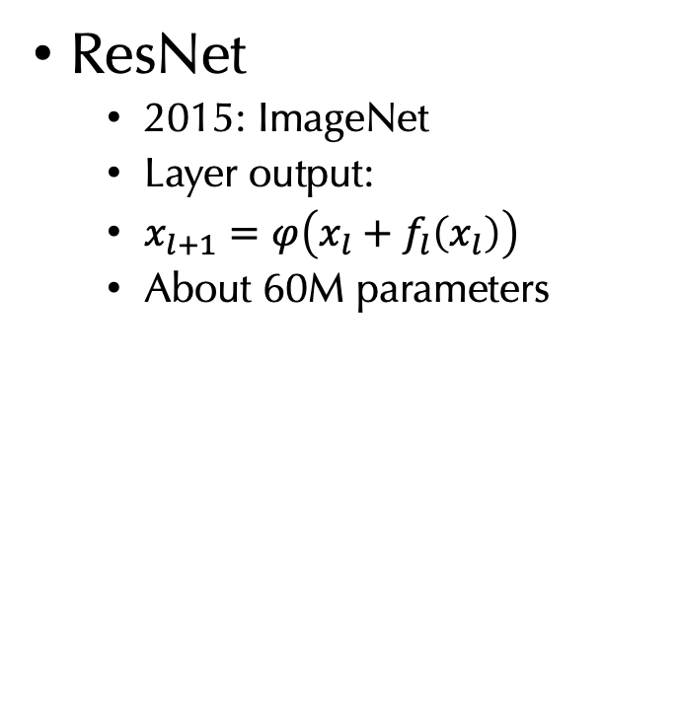
Three Example architectures
LeNet
1998
Activations: tanh
4.1% error to 1.2%
About 60k parameters
AlexNet
2012: ImageNet challenge
26% error down to 15%
About 62.4M parameters
ResNet
2015: ImageNet
Layer output:
$x_{l+1}=φ\left(x_{l}+f_{l}\left(x_{l}\right)\right)$
About 60M parameters

Slide 33
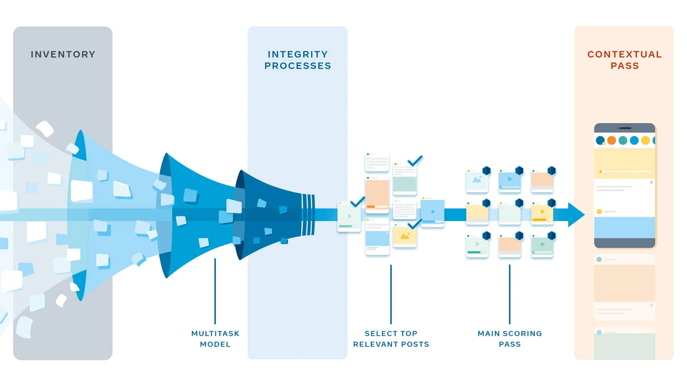




Where we are now
ML / AI is everywhere
Critical to businesses in almost all fields
Development is fast
Case study: LLaMa
Released 23. Feb 2023
Leaked 2. Mar 2023
Optimized local execution released 13. Mar 2023
Alpaca, fine-tuned to GPT-3 performance, 13. Mar 2023
Increasingly integrated into our lives, intentionally and unintentionally

Slide 34
The future
???

Slide 35
An Ahistorical introduction
Starting to think about how to think about your data

Slide 36
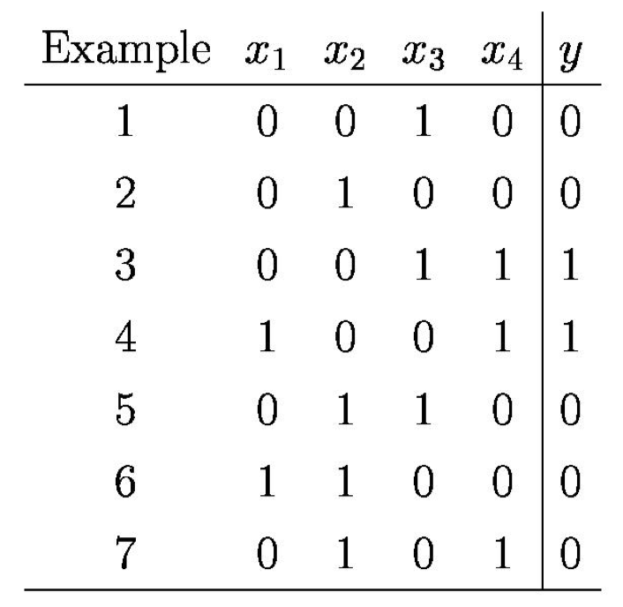
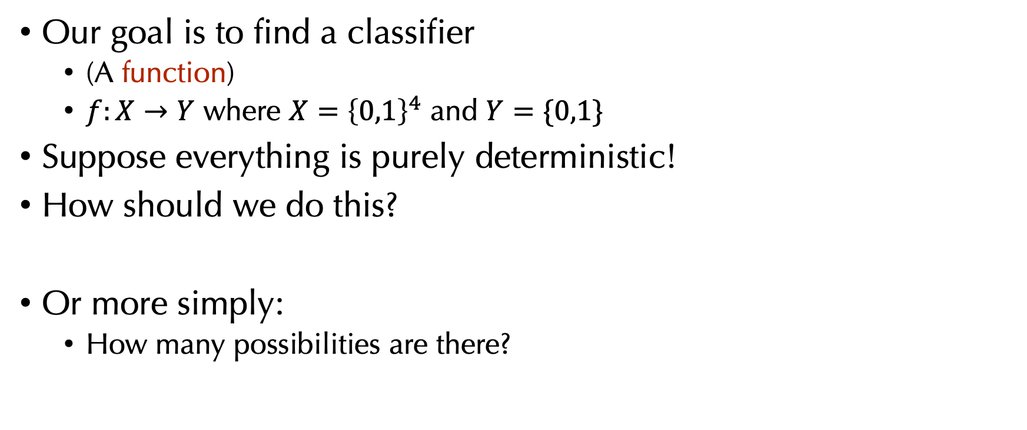
A contrived example
Our goal is to find a classifier
(A function)
$f:X→Y$ where $X={\left\{0,1\right\}}^{4}$ and $Y=\{0,1\}$
Suppose everything is purely deterministic!
How should we do this?
Or more simply:
How many possibilities are there?

Slide 37
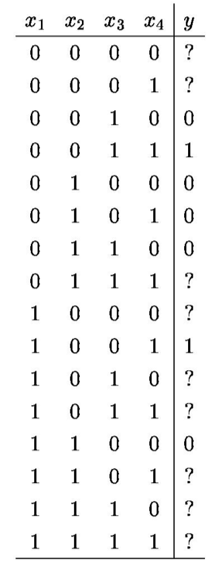
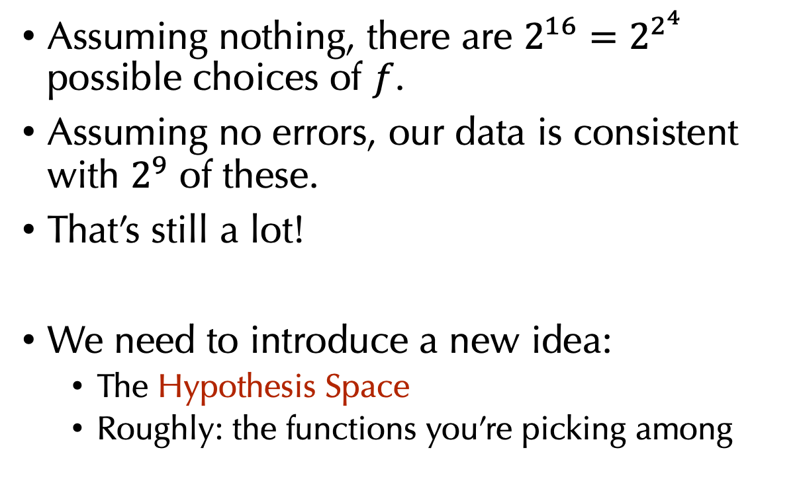
One possibility
Assuming nothing, there are $2^{16}=2^{2^{4}}$ possible choices of $f$.
Assuming no errors, our data is consistent with $2^{9}$ of these.
That’s still a lot!
We need to introduce a new idea:
The Hypothesis Space
Roughly: the functions you’re picking among

Slide 38
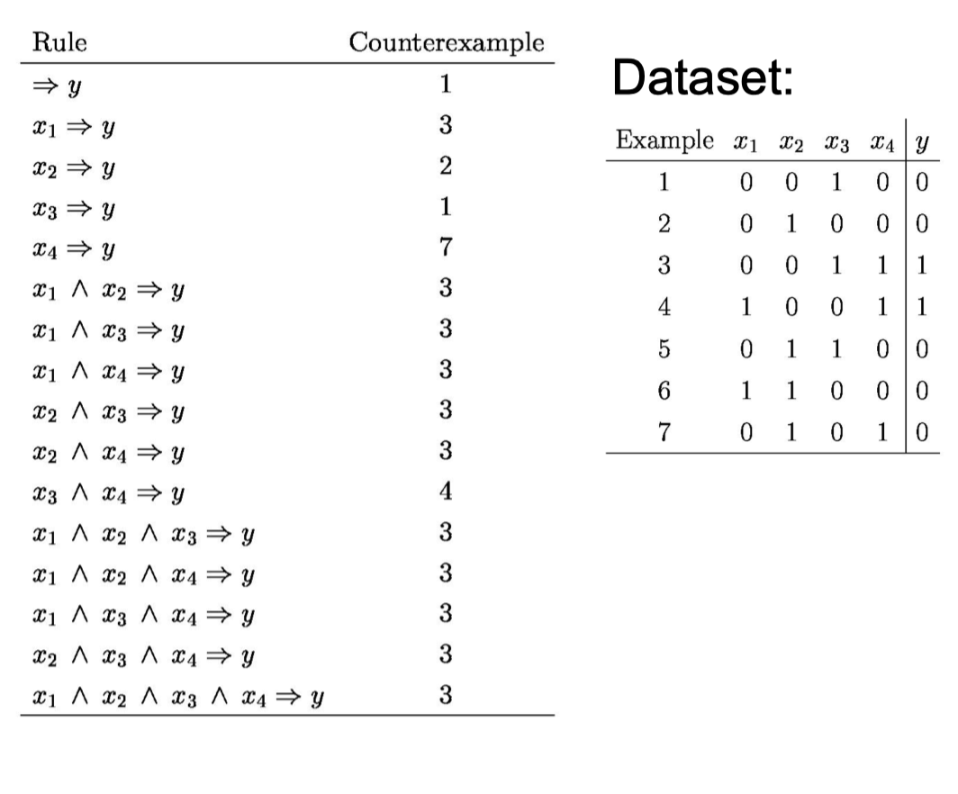
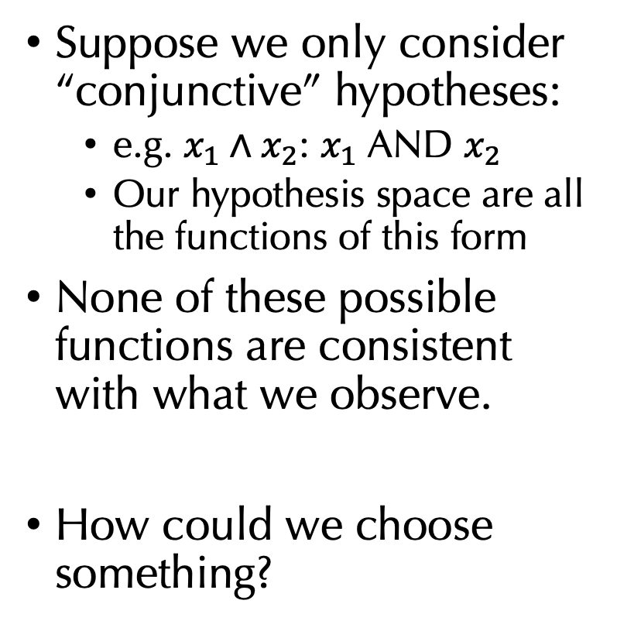
Restrictions
Suppose we only consider “conjunctive” hypotheses:
e.g. $x_{1}∧x_{2}$: $x_{1}$ AND $x_{2}$
Our hypothesis space are all the functions of this form
None of these possible functions are consistent with what we observe.
How could we choose something?

Slide 39
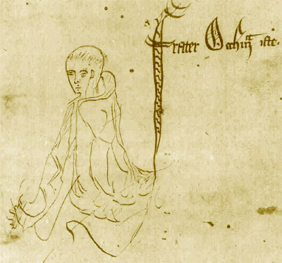
Occam’s Razor
One should not increase the number of entities required to explain anything beyond what is necessary.
But what is simplicity?
And what is necessary?

Slide 40
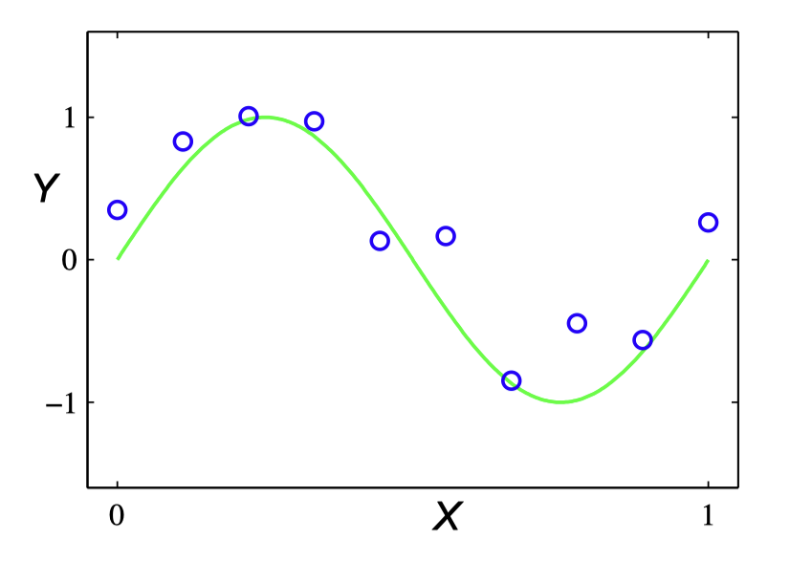
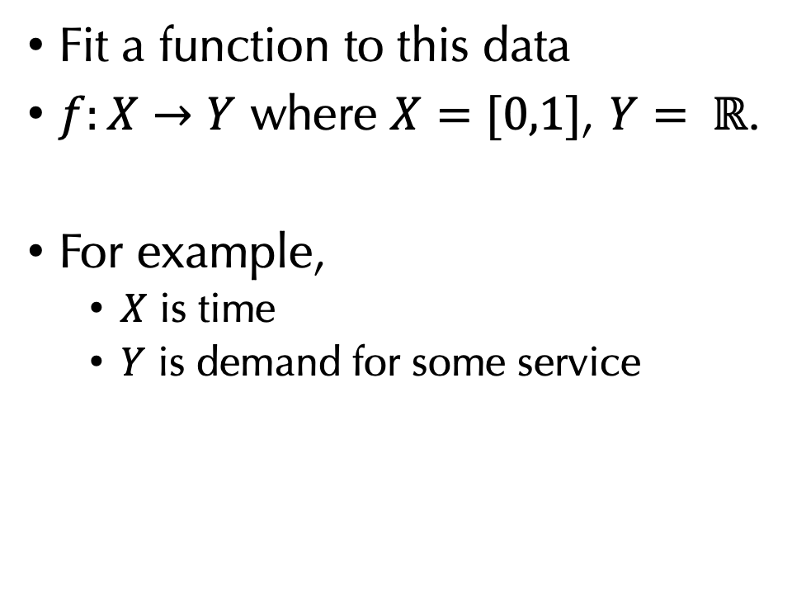
A less contrived example
Fit a function to this data
$f:X→Y$ where $X=[0,1]$, $Y= ℝ$.
For example,
$X$ is time
$Y$ is demand for some service

Slide 41
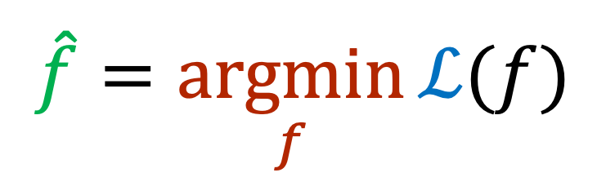
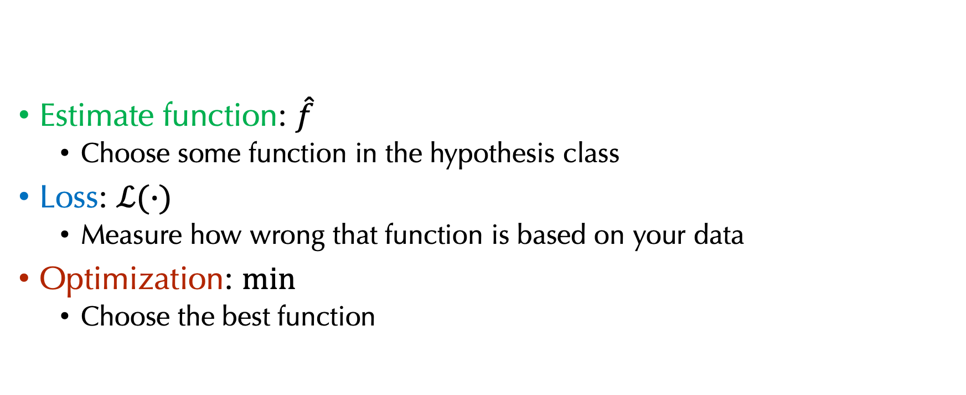
How do we learn?
Estimate function: $\hat{f}$
Choose some function in the hypothesis class
Loss: $ℒ(∙)$
Measure how wrong that function is based on your data
Optimization: $min$
Choose the best function
$$\hat{f}=\underset{f}{argmin}{ℒ(f)}$$

Slide 42
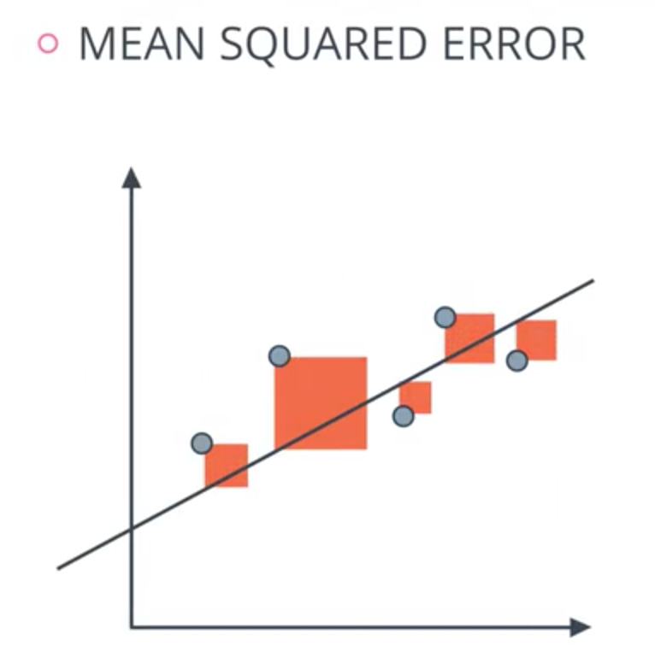
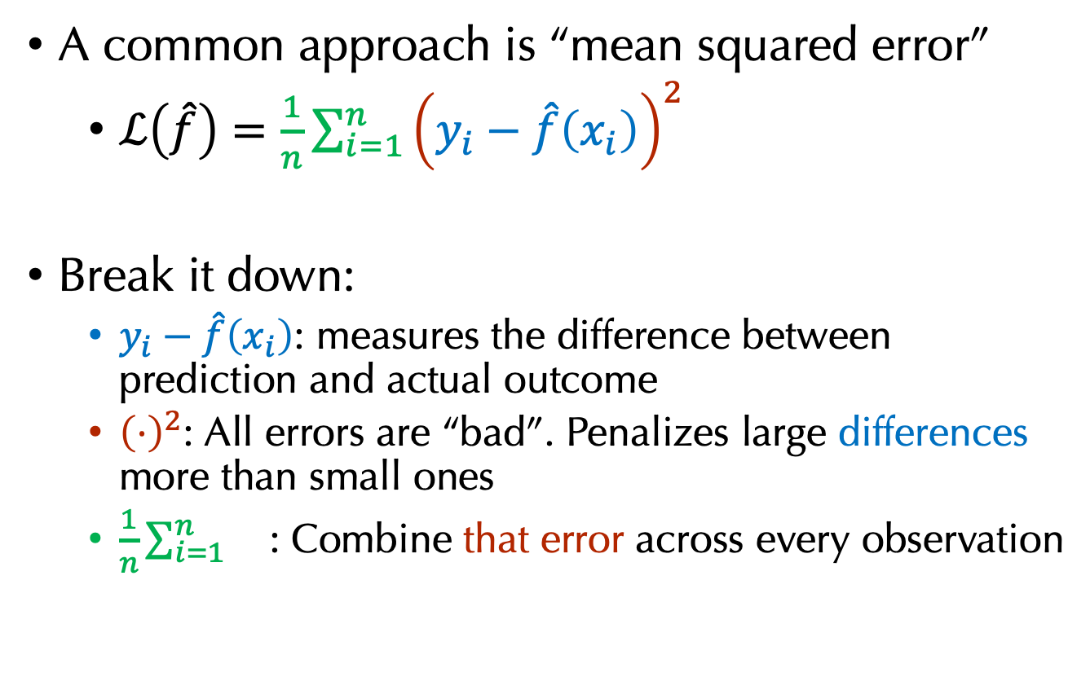



Measuring loss
A common approach is “mean squared error”
$ℒ\left(\hat{f}\right)=\frac{1}{n}\sum_{i=1}^{n}{{\left(y_{i}−\hat{f}\left(x_{i}\right)\right)}^{2}}$
Break it down:
$y_{i}−\hat{f}\left(x_{i}\right)$: measures the difference between prediction and actual outcome
${\left(⋅\right)}^{2}$: All errors are “bad”. Penalizes large differences more than small ones
$\frac{1}{n}\sum_{i=1}^{n}{}$: Combine that error across every observation
$$(x,y)$$
$${\left(y−\hat{f}\left(x\right)\right)}^{2}$$
$$\hat{f}(x)$$
Notes:
Add something showing what mean squared error looks like on a regression problem

Slide 43


What kinds of functions should we use?
A reasonable choice, perhaps?
$f\left(X\right)=β_{0}+β_{1}X+β_{2}X^{2}+…+β_{K}X^{K}$
But which degree should we use?

Slide 44

Measure the error for different models
Each point shows the error for one of the models

Slide 45



Bias / variance tradeoff
$$\text{bias}\left(\hat{θ}\right)= 𝔼\left[\hat{θ}\right]−θ$$
$$\text{MSE}\left(\hat{θ}\right)=V\text{ar}\left(\hat{θ}\right)+\text{bias}{\left(θ\right)}^{2}$$
Bias: How expressive is the model?
Variance: How hard is it to find the right model
A central task of ML is to balance these two concepts
Takeaway: More data lets us use more expressive models!

Slide 46

Testing
We also need to be careful about how we measure the error.
Easy to overfit to the training data
When we just “memorize” the training data
Solution: “bind our hands” by measuring performance on a separate dataset.
This gives us a good idea of how well a model performs on any suitably similar data.

Slide 47

ML in context
What are the examples we’re training on?
Are they “good” examples?
What is pre-baked into the data we’re given?
How can we know if we’re exacerbating existing biases?

Slide 48
What is “fairness”?
Legitimacy
Is there any sense in which such a system should be deployed?
Precedes a discussion of the specific allocative risks / harms
Relative treatment of groups
How does the system allocate resources?
We will focus a lot on this, because we can measure aspects of this rigorously and quantitatively
That does not mean it is more important than legitimacy

Slide 49

The Purpose of a System is What it Does
“POSIWID”
Stafford Beer, a management consultant and cybernetician
When dealing with complex systems, focus on the results they generate
Don’t focus narrowly on “the algorithm”, try to evaluate the larger system it is part of

Slide 50
How can we measure this?
Stay for the exciting conclusion in Randomized Program Evaluation…

